Slide 1
Embedded C for 8051: Primer for CompEng 3150
Brad Ziegler
bziegler@mst.edu
October 2nd, 2018

Slide 2
Assumptions
You have taken an introductory programming course (likely c++)
You know a little about the architecture of the 8051 microcontroller

Slide 3
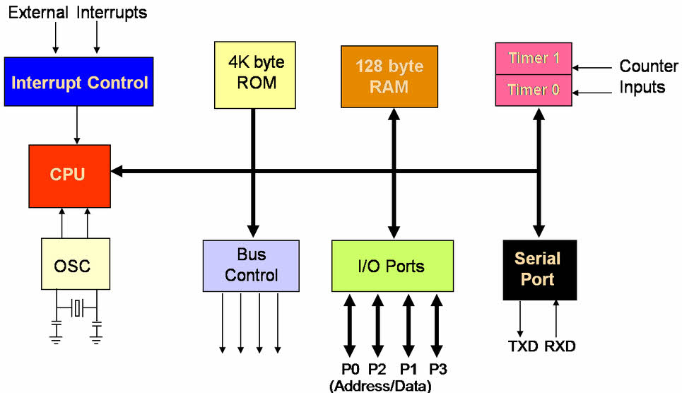
Review:
8051 generic architecture
Typical features of a modern 8051:
Thirty-two input / output lines.
Internal data (RAM) memory - 256 bytes
Up to 64 kbytes of ROM memory (usually flash)
Three 16-bit timers / counters
Nine interrupts (two external) with two priority levels.
Low-power Idle and Power-down modes.

Slide 4
Embedded C
Utilizes the C51 Linker built into Keil uVision
Structure of programs is much like C programs written for Linux or Windows
You can define functions like in C – helpful for breaking up blocks of code
Set values to a single data line (bit) or an entire bus (8-bits)
Comments can be done using // or /* */

Slide 5
The Cx51 Compiler provides several basic data types you may use in your C programs.
The compiler supports the standard C data types as well as several data types that are unique to the Cx51 platform.
Data Types
Data Types | Bits | Bytes | Value Range
bit | 1 |  | 0 to 1
signed char | 8 | 1 | -128 — +127
unsigned char | 8 | 1 | 0 — 255
enum | 8 / 16 | 1 or 2 | -128 — +127 or -32768 — +32767
signed short int | 16 | 2 | -32768 — +32767
unsigned short int | 16 | 2 | 0 — 65535
signed int | 16 | 2 | -32768 — +32767
unsigned int | 16 | 2 | 0 — 65535
signed long int | 32 | 4 | -2147483648 — +2147483647
unsigned long int | 32 | 4 | 0 — 4294967295
float | 32 | 4 | ±1.175494E-38 — ±3.402823E+38
double | 32 | 4 | ±1.175494E-38 — ±3.402823E+38
sbit | 1 |  | 0 or 1
sfr | 8 | 1 | 0 — 255
sfr16 | 16 | 2 | 0 — 65535

Slide 6
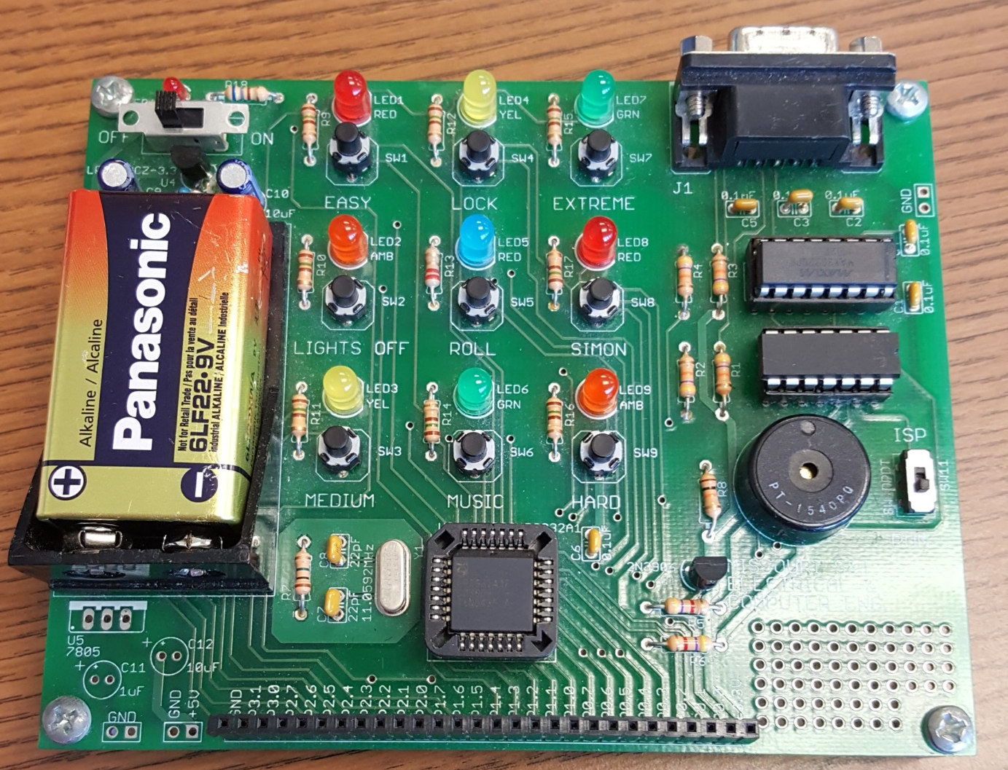
Simon Board 2

Slide 9
Hello World
Start with a super loop
Initialize port modes
Turn LED on for some time and then turn off

Slide 10
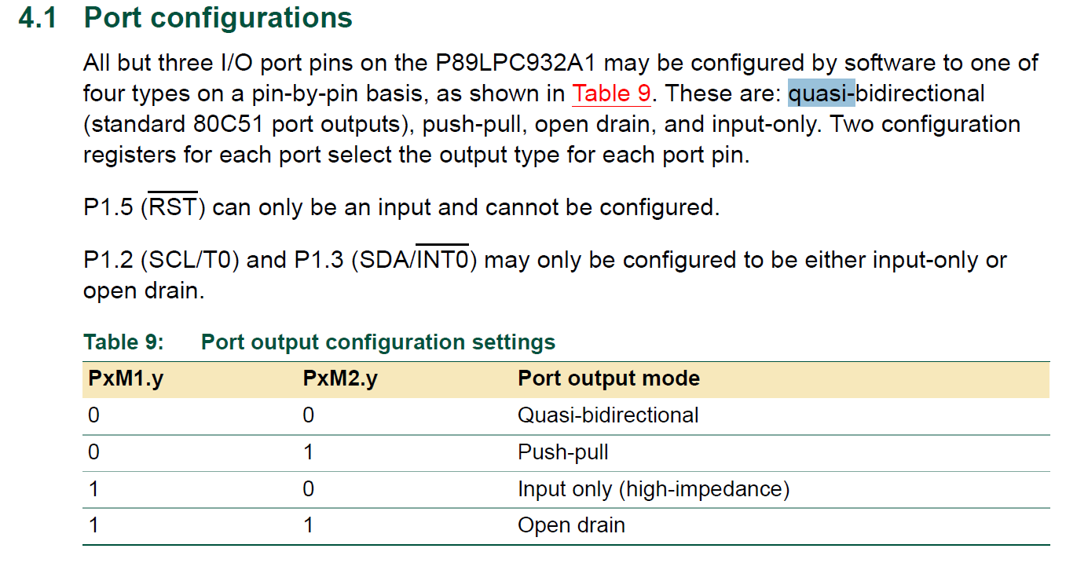

Slide 11
Problem:
Electronic door lock
Create a door lock mechanism that requires you to enter a three-digit code and then verify the code. If both codes match, the door locks. If not, an error indicator is shown.
Three indicators: RED – Locked, Yellow – Verify, Green – Unlocked

Slide 12
LEDs
P2.4 – Red
P0.5 – Yellow
P2.7 – Green
Switches
P2.1 – Left
P0.3 – Middle
P2.2 – Right

Slide 13
Resources
Cx51 User’s Guide http://www.keil.com/support/man/docs/c51/c51_intro.htm
ECE Intro to Comp Eng https://sites.google.com/a/mst.edu/introtocpe/home
  Simon Board information, code samples, .hex files
The 8052 Online Resource http://www.8052mcu.com/
Pont, Michael. Embedded C. Pearson Education, 2002
http://www.ecpe.nu.ac.th/ponpisut/22323006-Embedded-c-Tutorial-8051.pdf

